Slide 1
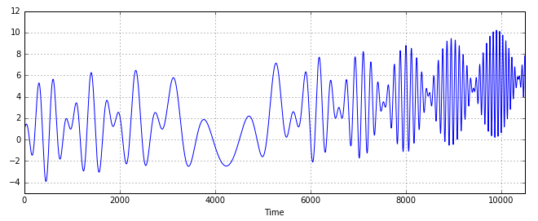
Output
OK
NG
Long Short Term Memory
Fully Connected
x
x
+
+
+
+
+
+
+
+
x
x
x
x
x
x
tanh
학습
tanh
x
x
x
x
tanh
tanh
Input
Input
Chunk

Slide 2
Output
layer
x
x
+
+
+
+
+
+
+
+
x
x
x
x
x
x
tanh
tanh
x
x
x
x
Long Short Term Memory
tanh
tanh
Input
Input

Slide 3
